Slide 1
Introduction to C++ Programming Language
C++ is a powerful and versatile programming language that was developed by Bjarne Stroustrup in 1983.
It is an extension of the C programming language and is widely used in various domains due to its efficiency, performance, and support for object-oriented programming.

Slide 2
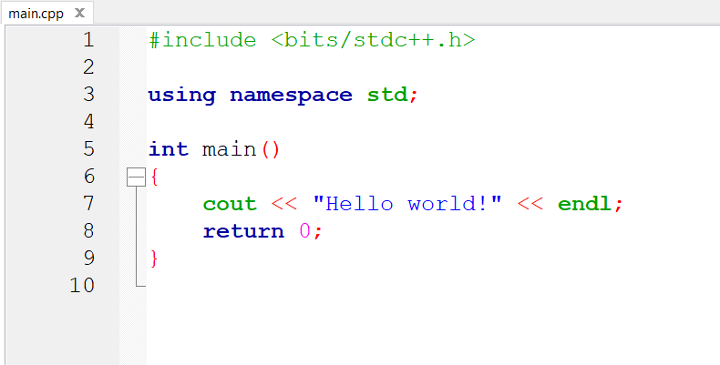
C++ Basics
Preprocessor directives
They are directives that tell the compiler to process the source code before compiling.
Begin with a ‘#’(hash) symbol.
Number of preprocessor directives
- #define(macro definition), #include(include a file),etc.
- Main function: Entry point of the program.
Namespace
It provides the space to define or declare identifier i.e. variable, method, classes to avoid name collision.
The using directive allows for a concise code. By avoiding prepending of namespaces.
Here the std declaration is used to access elements from the standard C++ library without explicitly qualifying them with “std::”.
“endl” and ‘\n’ are both new line commands. However ‘endl’ forces the output buffer to be flushed but the ‘\n’ doesn’t. As a result it is faster.
Figure: THE BASIC PROGRAM STRUCTURE
Main is the entry point of the program.

Slide 3
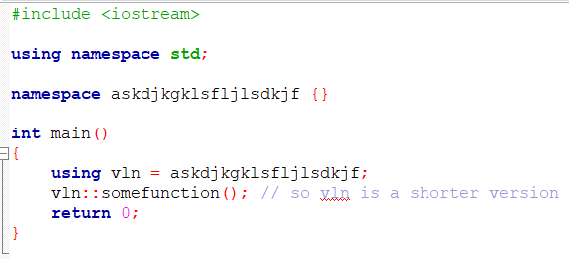
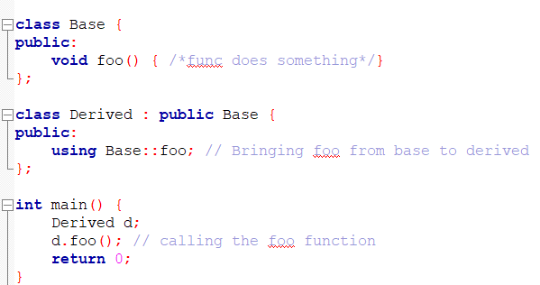
The ‘Using’ keyword
The using keyword has a couple of different uses:
Namespace alias: One can use ‘using’ to create a shorter alias for a namespace. Thus, no need to prepend the namespace name again and again
Using for inheritance: it can also be used to bring specific members from a base class into the scope of a derived class
Using for aliasing:

Slide 4


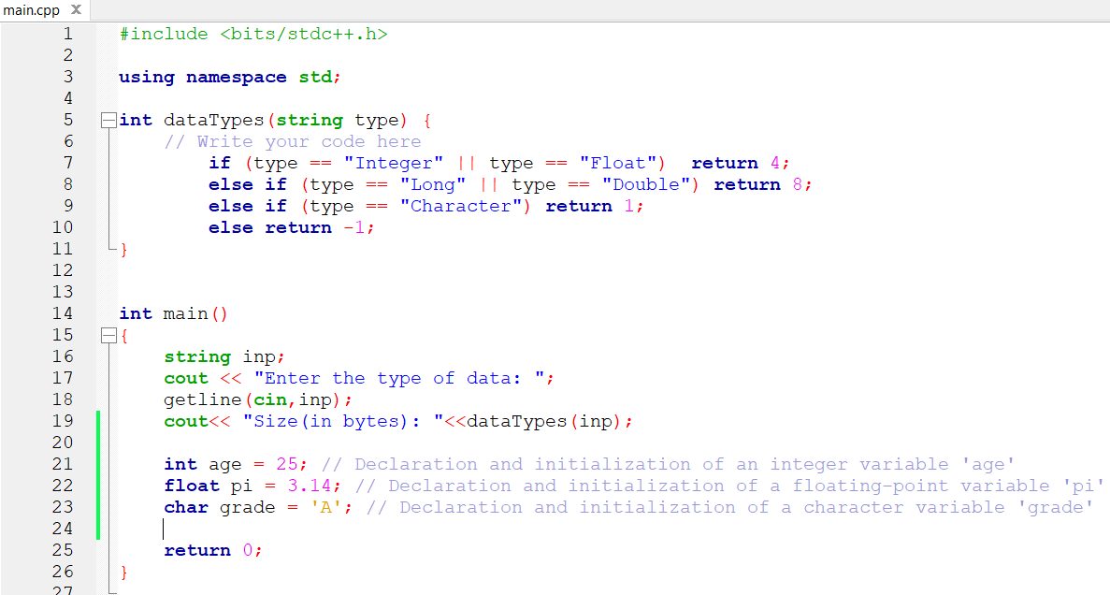



Variables and Data Types
Data Types in C++
C++ supports various data types,
Fundamental types (int, float, double, char, bool),
Modifier types (short, long, signed, unsigned),
User-defined types (struct, enum).
Each data type has a specific size in memory and can store different ranges of values.
Declaring and Initializing Variables
Variables are used to store data in a program. In C++, you declare a variable with its data type, followed by its name.
Variables can be initialized during declaration using the assignment operator (=).

Slide 5
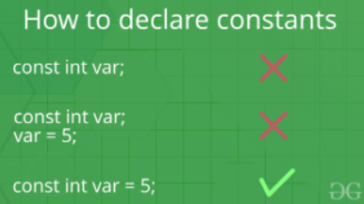
Const keyword in C++
When the keyword is attached to any method(), variable, or pointer variable , and with object of a class it prevents that specific object/method()/variable to modify its data items value.
There are certain rules for the declaration and initialization of the constant variables:
cannot be left un-initialized at the time of the assignment.
It cannot be assigned value anywhere in the program
Explicit value needed to be provided to the constant variable at the time of declaration of the constant variable

Slide 6
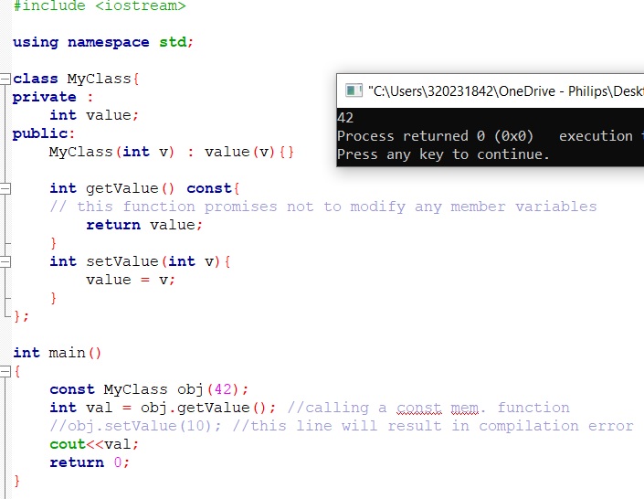
Const keyword in class member functions in C++
A ‘const’ member function promises not to modify the object it’s called on. This helps ensure program correctness and helps prevent unintended modification to data.
In the example, getValue() function marked as const which means it can be called safely on const instances of the class.
However, the setValue() function is not marked as const, which means it can only be called on non-const instances.

Slide 7
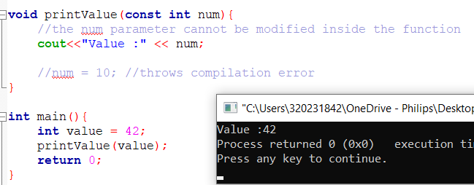
Const keyword in class function parameters in C++
The use of const keyword to declare function parameters as const to indicate that the function will not modify the values of those parameters.
In the example printValue() function takes an integer parameter num that is declared as const. This means that within the function, you cannot modify the value of num as attempted by the commented-out line ‘num = 10’.

Slide 8
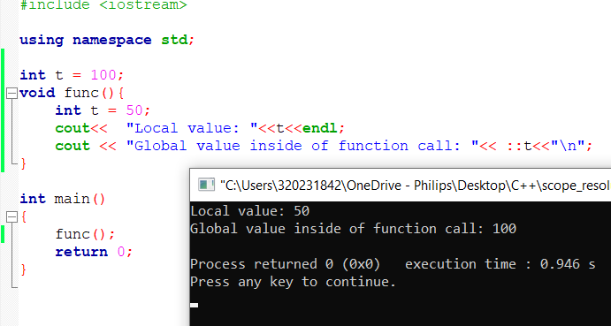
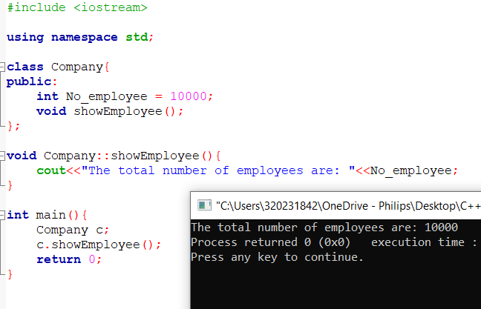
Scope resolution operator( :: )
The scope resolution operator is used to reference the global variable or member function that is out of scope.
USES:
It is used to access the hidden variables or member functions of a program
It defines the member function outside of the class using the scope resolution.

Slide 9
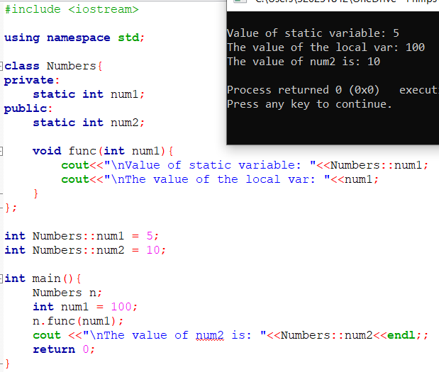
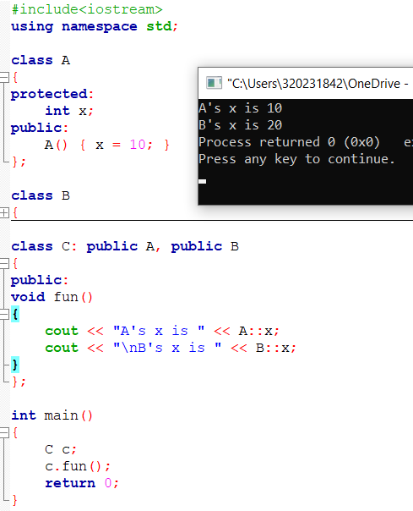
It is used to access the static variable and static function of a class.
4. The scope resolution operator is used in case of multiple inheritance to resolve the scope.

Slide 10
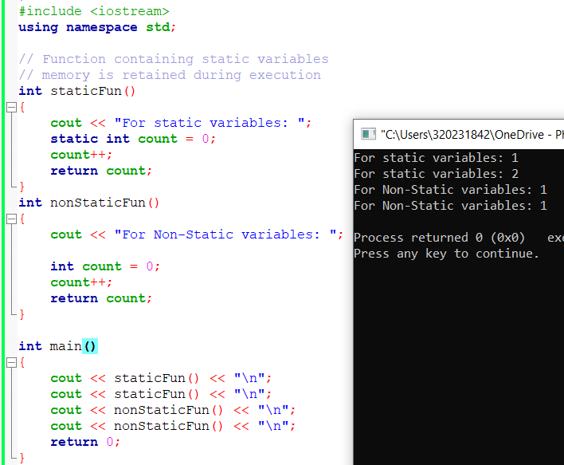
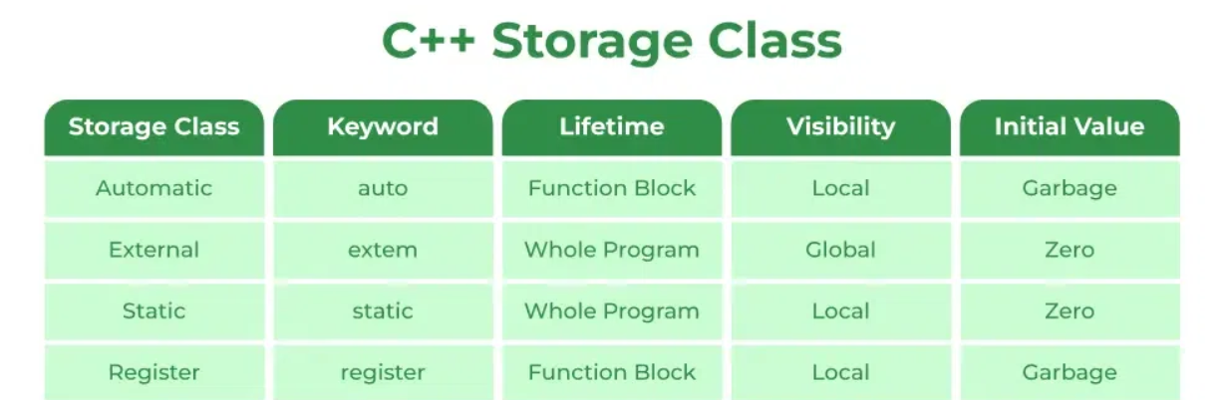
Storage classes in C++
Auto – the default class to which all the variables get assigned to
Extern – makes a variable accessible to all blocks of scope and to other files which are part of the larger program.
Static – the static keyword makes a variable retain its value even they are out of scope
Register – same as auto variables auto variables but they are stored in registers and not in memory itself.

Slide 11
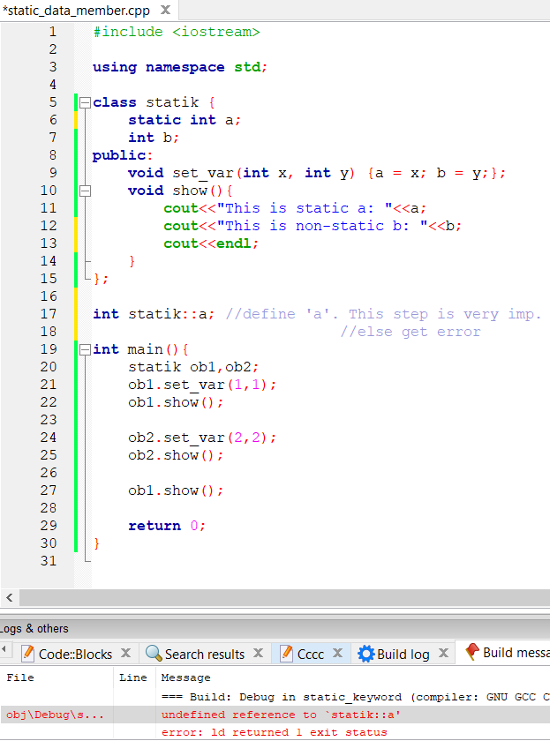
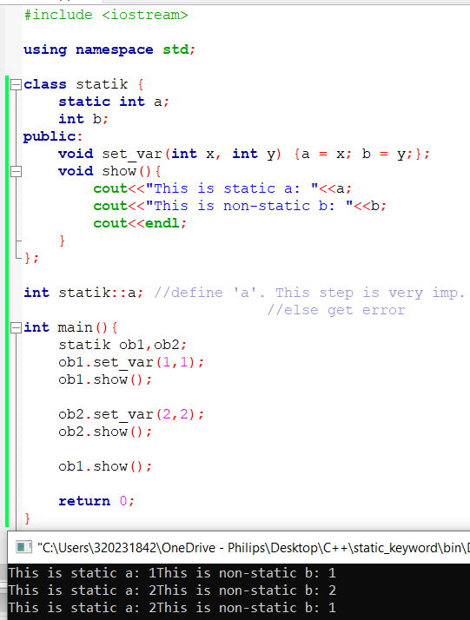
Use of Static keyword
Use along with variables:
The space allocated of the variable gets allocated for the lifetime of the program.
In consecutive function call the static variable retains its value from the previous function call.
Use along with objects and classes:
When a data member inside a class is declared as static it means to the compiler that only one copy of that variable will exist and that all objects of the class will share the same variable.
A public static member variable of a class can directly be accessed inside main() by referencing it like this:
Example: statik::a = 99;
For static member functions they can access only the static data members and functions belonging to the class.
Static member function doesn’t have this pointer.
Static and non-static version of the same function cannot exist together. Also, cannot be declared as const or volatile.
X object retains the value of ‘a’ as 2

Slide 12
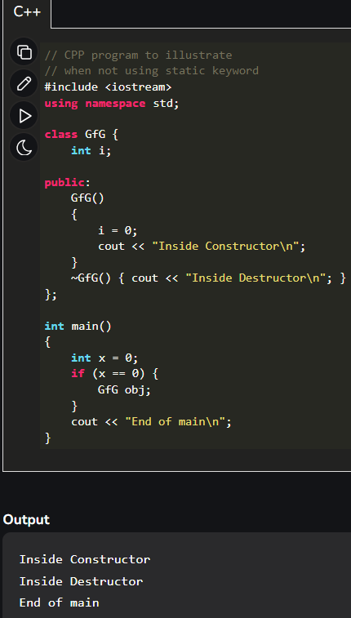
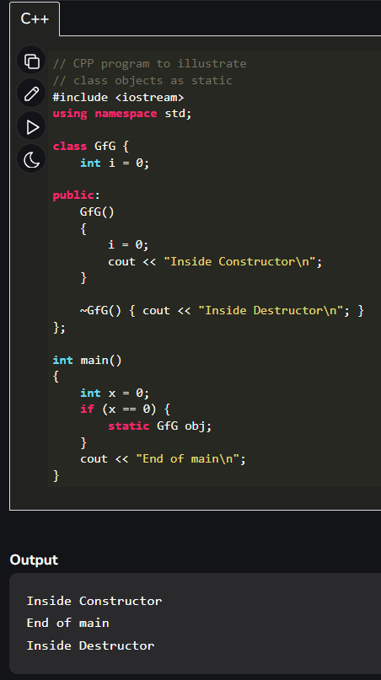
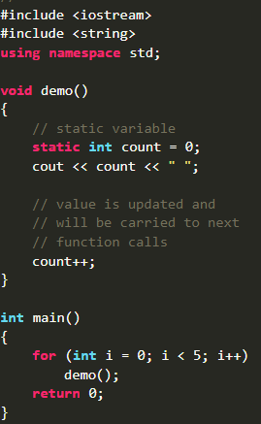
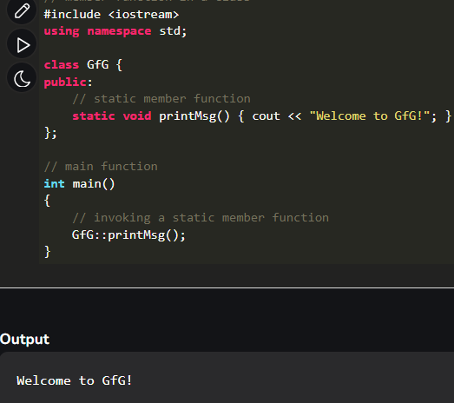

Examples of previous slide:
Static Object
Static variable
Static member function
OUTPUT

Slide 13
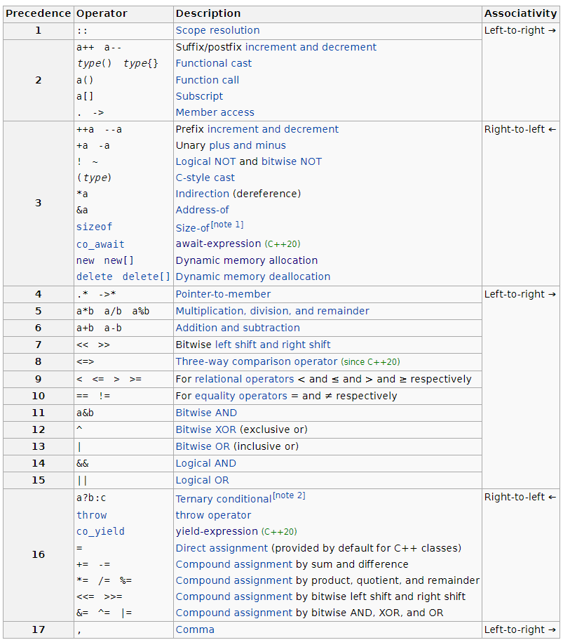
Precedence and associativity of operators
Associativity implies which operator is executed first in the tie of operator execution.

Slide 14
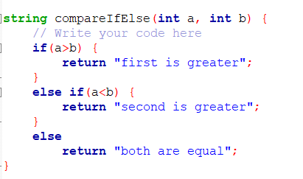
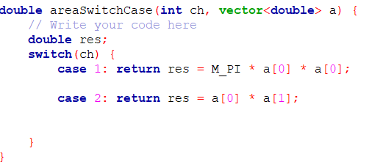
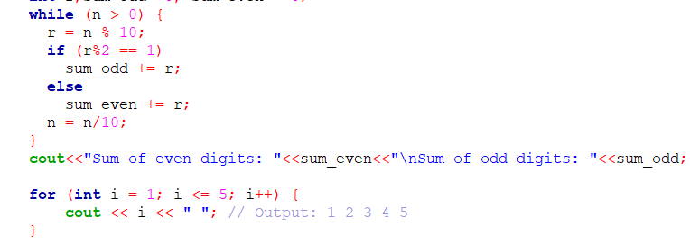
Control Structures
Conditional Statements
Conditional statements allow the program to make decisions based on certain conditions.
The "if" statement checks a condition and executes a block of code if the condition is true.
The "else" statement provides an alternative block of code to execute if the condition is false.
The "switch" statement checks the value of an expression and executes the code block associated with the matching "case" label.
Looping Statements
Looping statements, such as "for," "while" and "do-while" are used to execute a block of code repeatedly if a certain condition is met.
"for" and "while" loops are entry-controlled loops, which means the condition is checked before the loop's execution.
"do-while" is an exit-controlled loop, where the condition is checked after the loop's execution.
Figure: Use of if-else, while and for loop

Slide 15
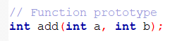
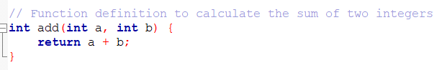
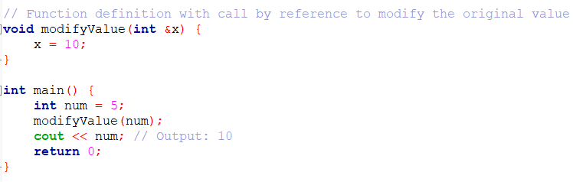
Functions
Functions prototype
Function prototypes tell the compiler about the existence and interface of the functions, while the definitions contain the actual code.
Defining Functions in C++
Functions are blocks of code that can be called and executed at various points in the program.
Return type
Function Parameters
Using &(ampersand) to pass the memory address to the function
Function name
C++ allows passing arguments to functions by value or by reference. When using call by value, a copy of the argument is passed to the function, while call by reference passes the memory address of the argument.
Functions pass by value or by reference

Slide 16
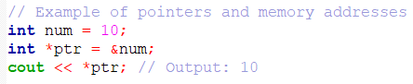
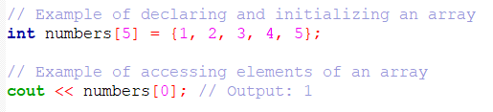
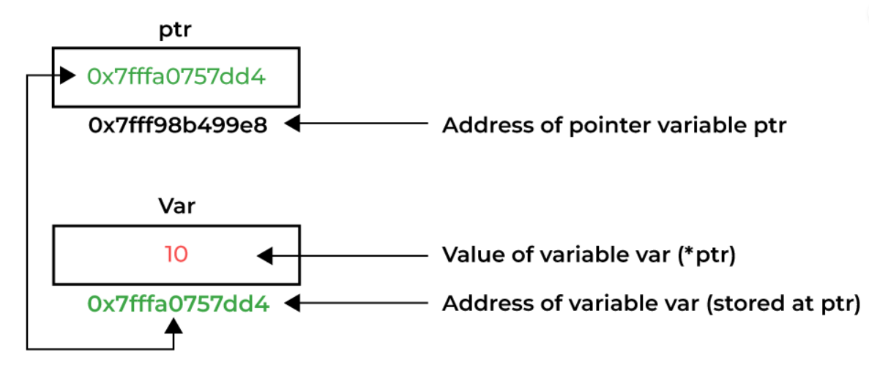
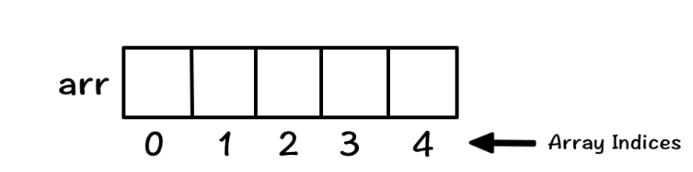
Arrays and Pointers
Declaring and Initializing Arrays
Arrays are a collection of elements of the same data type stored in contiguous memory locations.
In C++, you can declare and initialize an array using square brackets [ ]. Arrays have a fixed size, and the size must be known at compile-time.
- Accessing Elements of Arrays can be done as shown in the example code
Pointers and Memory Addresses
Pointers are variables that store the memory addresses of other variables.
The '&' operator is used to get the memory address of a variable, and the '*' operator is used to declare and dereference pointers.

Slide 17
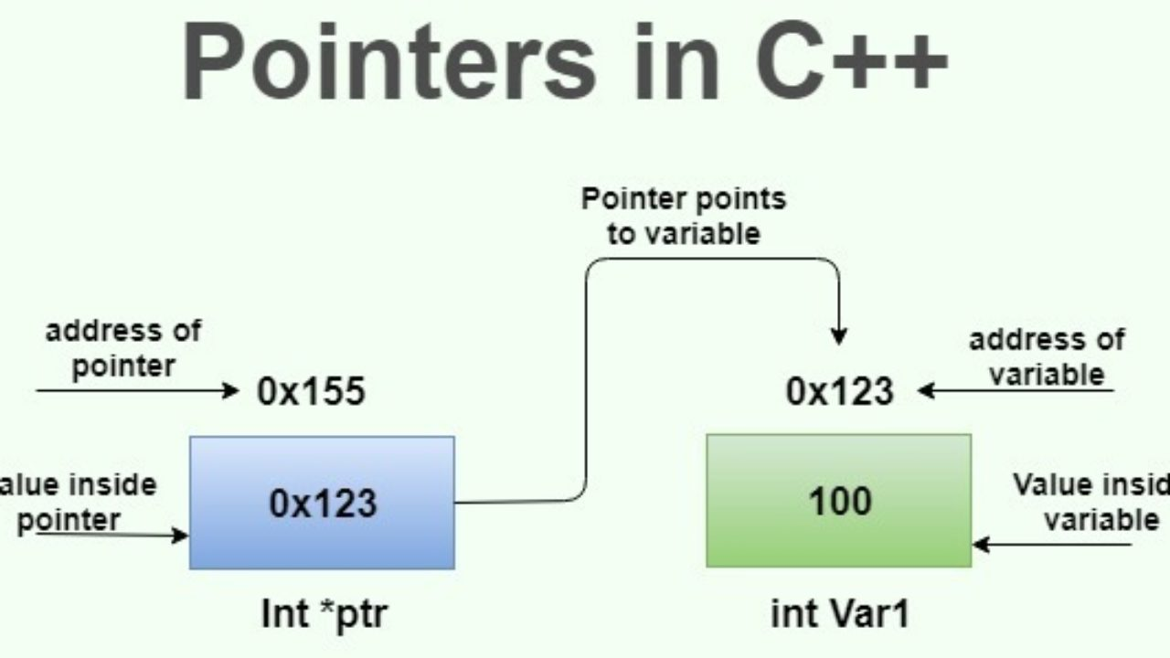
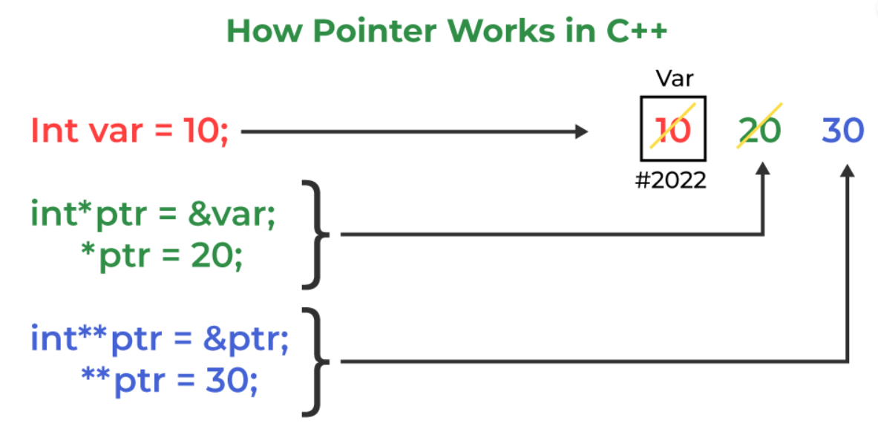
Pointers in depth
Pointers are nothing but variables that hold memory address. The address is of another object(usually another variable)
Declaration:
type *name
type: can be anything from standard types like int, float etc., to user-defined types using struct or class.
name: As one likes.
The pointer Operators:
& - returns the memory address of its operand.
Ex: m = &count;
* - deference operator. Return the content of a pointer variable. Ex: q = *m;(value in count is stored to q)
NOTE: * and & have higher precedence than all other arithmetic operators except unary minus with which they are equal

Slide 18
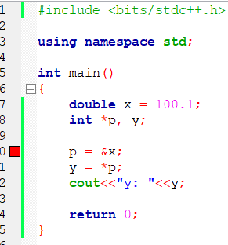
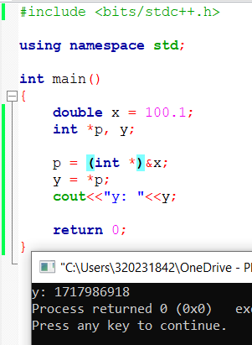
The error is due to no casting. Casting is essential that too explicit in C++. No implicit casting

Slide 19
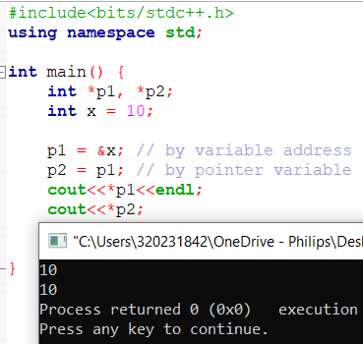
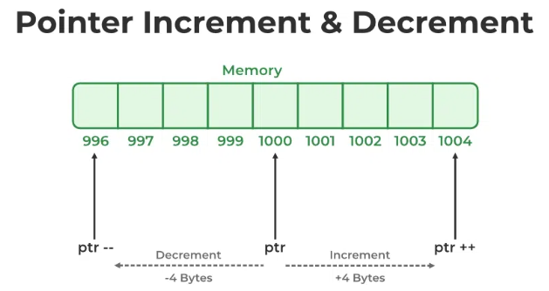
Pointer Expressions
Pointer Assignments:
By address
By pointer
Pointer Arithmetic:
Arithmetic refers to increment or decrement of pointers.
Apart from adding a pointer and an integer one can perform only subtraction of pointers. No other operation of pointer is allowed

Slide 20
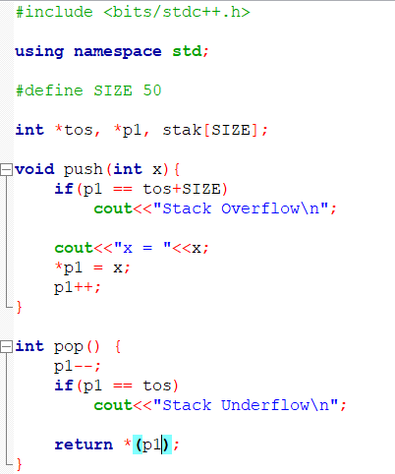
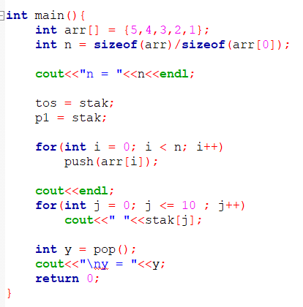
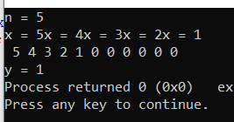
Pointer comparison:
Can compare pointers using relational expressions like (==, >=, <=, >,<, !=)
Comparison happens to check whether one pointer is lower in address or higher in address
OUTPUT:

Slide 21
Pointer to array:
It is simple. Just simply get the address of the 0th element either way as shown below:
int *p, arr[10];
p = &arr[0];
OR p = arr;
To access an element of array we need to do it same as indexing, i.e.
arr[4] is same as *(a+4)
In terms of speed the array indexing is slower as compared to pointer arithmetic. Hence using it is better.

Slide 22
Strings:

Slide 23
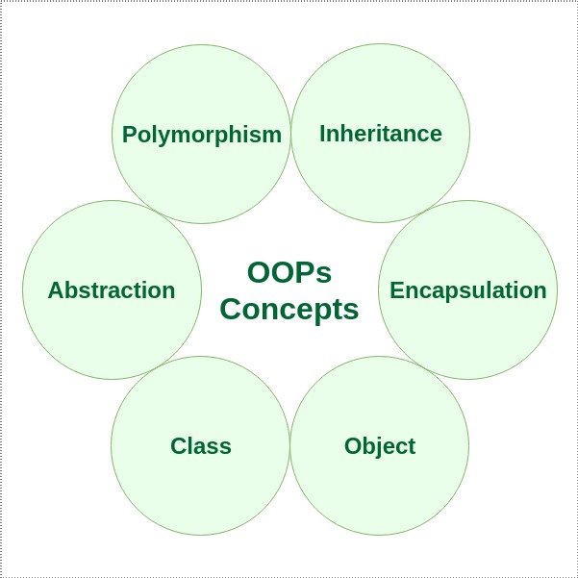
Object-Oriented Programming
Object-Oriented Programming is a programming paradigm that organizes code into objects, which are instances of classes.
OOP is based on the concept of "objects" that encapsulate data and behavior, promoting modularity, reusability, and ease of maintenance.
Advantages of OOP: Encapsulation, Inheritance, Polymorphism, Abstraction(which we will get into in later slides)

Slide 24
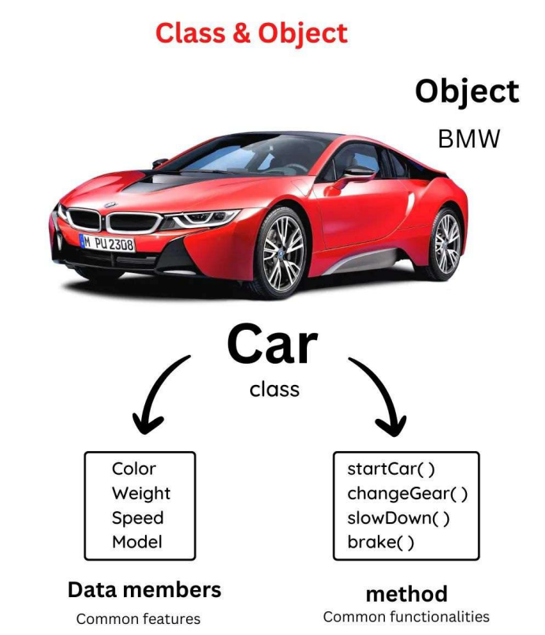
Classes
and
Objects

Slide 25
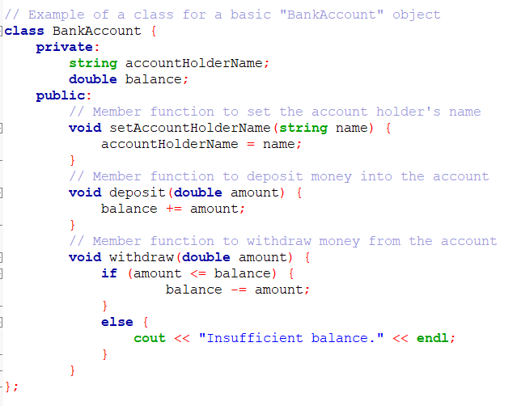
Classes and Objects
A class is a user-defined data type that serves as a blueprint for creating objects.
It contains data members (attributes) and member functions (methods). The class encapsulates the data and behavior of objects.
Objects are instances of classes, created based on the class blueprint.
Each object has its own set of data and can perform actions defined by the class's member functions.
Data Members
Data members are private by default
Member Functions

Slide 26
Classes And Structures
When we talk about structures, we have all the same things as for classes, but the difference lies in the fact that the member variables of the struct are public by default.
But the classes have member variables that are private by default.

Slide 27
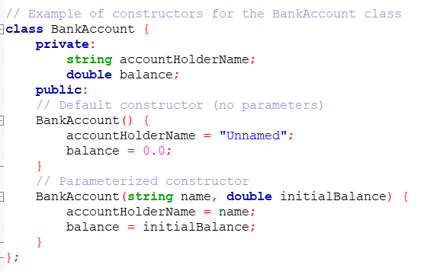
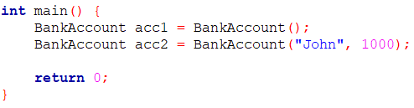
Constructors
Special member functions that get called when an object is created.
Responsible for initializing data members and preparing the object for use.
Can be overloaded to provide multiple ways of initializing objects.
Some rules for constructors are:
They don’t have any return type.
It has the same name as the class itself
Single argument constructors are special as they can initialize an object just as we do a variable.
Ex: X ob = X(99); //is same as
X ob = 99

Slide 28
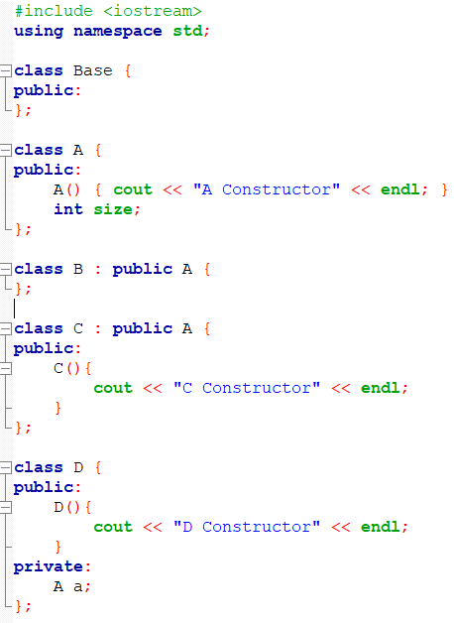
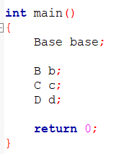
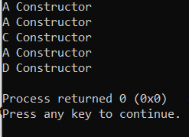
DEFAULT AND USER DEFINED CONSTRUCTORS

Slide 29
Destructors

Slide 30
Objects:
Passing objects to functions:
It is same as that of variables but the scene for constructors and destructors is somewhat different.
When a copy of an object is created while a function call to be used as an argument to the function, the normal constructor is not called. Instead, the default copy constructor makes a bit-by-bit identical copy. However, when the copy is destroyed (usually by going out of scope when the function returns), the destructor is called

Slide 31
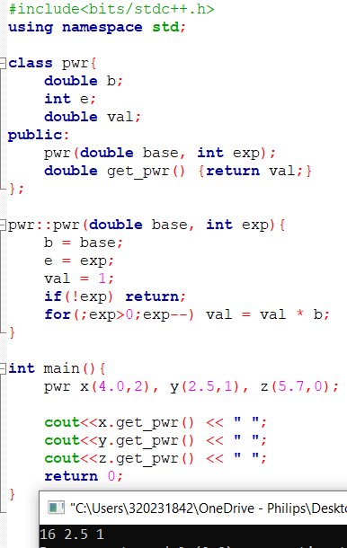
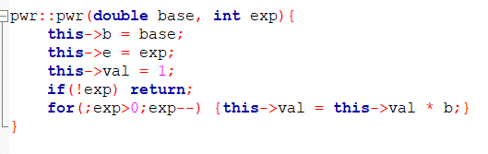
‘this’ pointer:
The ‘this’ pointer is passed as an implicit argument that is a pointer to the invoking object.
When a member function is called , it is automatically passed this argument
Here is an example:
Here the b = base can be replaced as
this->b = base
Likewise, we can do this:
Still the output will be same.

Slide 32
Friend Function:
Has access to all the private and protected members of that class.
Need to declare the function prototype in that particular class with the keyword ‘friend’

Slide 33
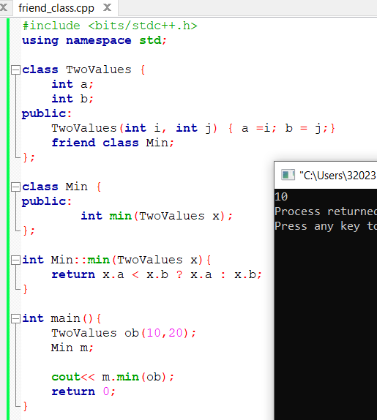
Friend Class:
Same as friend functions this class also access to all the private and protected members it is friend of.
Need to be declared using ‘friend’ preceding the class name
This makes the class declared inside the other class its friend function. Here the ‘Min’ class is the friend of ‘TwoValues’ class.

Slide 34
Inline Functions:
Functions that precede with the keyword ‘inline’, the compiler takes that definition of that function and replaces the function call with the whole code that’s written as the function body.

Slide 35

Encapsulation

Slide 36
Encapsulation
Encapsulation is defined as binding together the data(variables) and the functions(methods) that manipulate them.
Two main features of Encapsulation:
Data Protection: Encapsulation protects the internal state of an object by keeping its data members private.
Information Hiding: Encapsulation hides the internal implementation details of a class from external code.
In C++, encapsulation is enabled using getters(read value), setters(write value) and access modifiers.

Slide 37


ACCESS MODIFIERS

Slide 38


Slide 39

Inheritance

Slide 40


Inheritance
A key concept in OOP that allows a class to inherit data members and member functions from another class.
Promotes code reuse and creates a hierarchy of classes.
The base class contains common features shared by the derived classes. The derived class inherits these features and can have additional data members and member functions specific to its needs.
This relationship is indicated using the "public," "private," or "protected" access specifiers.
Modes of Inheritance

Slide 41



Types of INHERITANCE
Multilevel Inheritance
Single inheritance
Multiple Inheritance

Slide 42



Virtual Class
Consider a scenario like this
This creates ambiguity because if we do this it throws an error. So correct code will be:
Issue is that we have two copies (supposedly) of A.

Slide 43

Polymorphism

Slide 44


Polymorphism
Allows objects to take multiple forms depending on the context.
Compile-time (Static) Polymorphism:
Function Overloading: Multiple functions with the same name but different parameter lists.
The correct function is determined at compile-time based on the number or types of arguments passed to it.
Runtime (Dynamic) Polymorphism:
Function Overriding: Derived classes provide specific implementations for virtual functions.
It allows a derived class to provide a specific implementation of a virtual function defined in its base class
The appropriate function is determined at runtime based on the actual object type.
Function Overloading

Slide 45

Virtual Functions
But the main use of polymorphism is when a parent class reference is used to refer to a child class object.
The virtual functions are dynamic as in the concept is when they are declared as such they look for the latest overridden definition of the function in the derived classes.
If its there, then that version is given as the output. Otherwise, the base class version of the function performs the necessary desired outcome.

Slide 46

Abstraction
The process of simplifying complex systems by breaking them into smaller, manageable parts.
In C++, abstraction is achieved using classes and member functions, where the internal implementation details are hidden from the user.
Pure Virtual Functions and Abstract Classes:
Pure virtual function: Declared in a base class but has no implementation.
Abstract class: Contains at least one pure virtual function. Cannot be instantiated but can be used as a base class for derived classes.

Slide 48



Slide 49
C vs. C++:
- Procedural vs. Object-Oriented Paradigm
- C++ supports classes, objects, inheritance, and polymorphism.
- C++ has the Standard Template Library (STL) for data structures and algorithms.
Comparisons with C Programming Language

Slide 50



Templates in C++
Templates are used to create generic functions and classes in C++.
In generic function or class the type of data upon which the function or class operates is specified as a parameter.
Thus one can use one function or clas with several different types of data without having to explicitly recode specific versions for each data type .
For generic function to be created the syntax is:
Template<class type> ret-type func-name(parameter list){
// body of the function
}
COMPILE ERROR
FINE
A generic function(a function definition proceeded by the template statement) is also sometimes called as a template function.
When compiler creates a specific version of this function, it is said to have created a specialization. This is also called as a generated function.
The generating of a function is referred to as instantiation.

Slide 51


Generic function can also be overloaded .
There are restrictions to overloaded generic functions. The overloaded function cannot perform some other function; the overloaded versions must all perform the same function – only datatype can differ.

Slide 52
Generic Classes:

Slide 53
C++ Standard Library
C++ Standard Library:
- A collection of pre-built classes and functions that simplify common programming tasks.
- Key Components: iostream, vector, string, algorithm
Explanation of the C++ Standard Library can be provided verbally during the presentation.

Slide 54
Thank you

